Slide 1


Submitted To:-
Mr. Kunal Goyal
Technical Trainer (CEA)
Submitted By:-
Rohit Singhal , C (191500676)
Shourya Jain, C (191500780)
Swapnil Sharma, G (191500838)
Swati Gupta, C (201599029)
Garima Rajpoot, J (201599011)

Slide 2
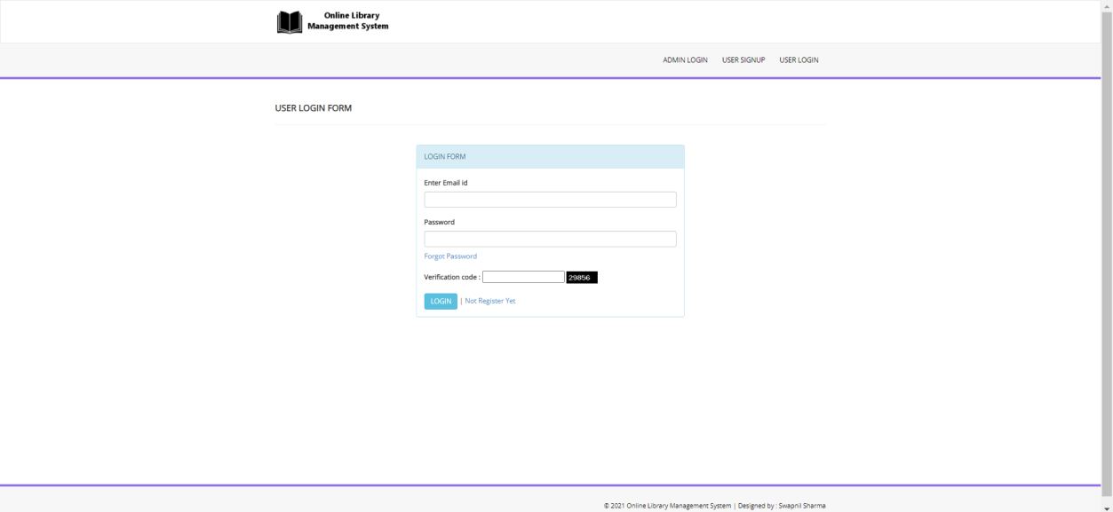
Login Page For Student

Slide 3
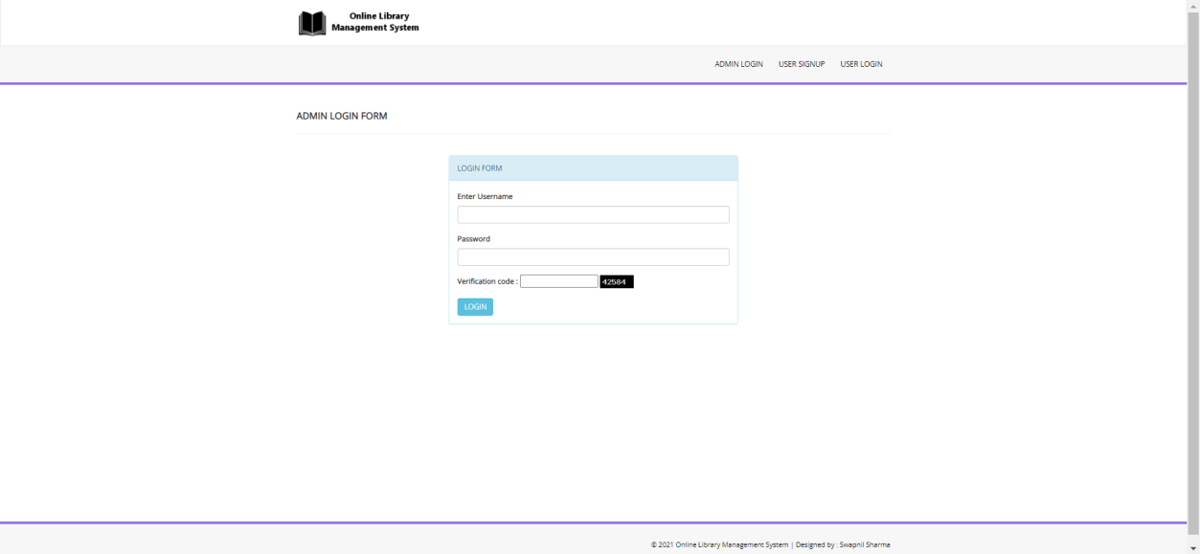
Login Page For ADMIN

Slide 4
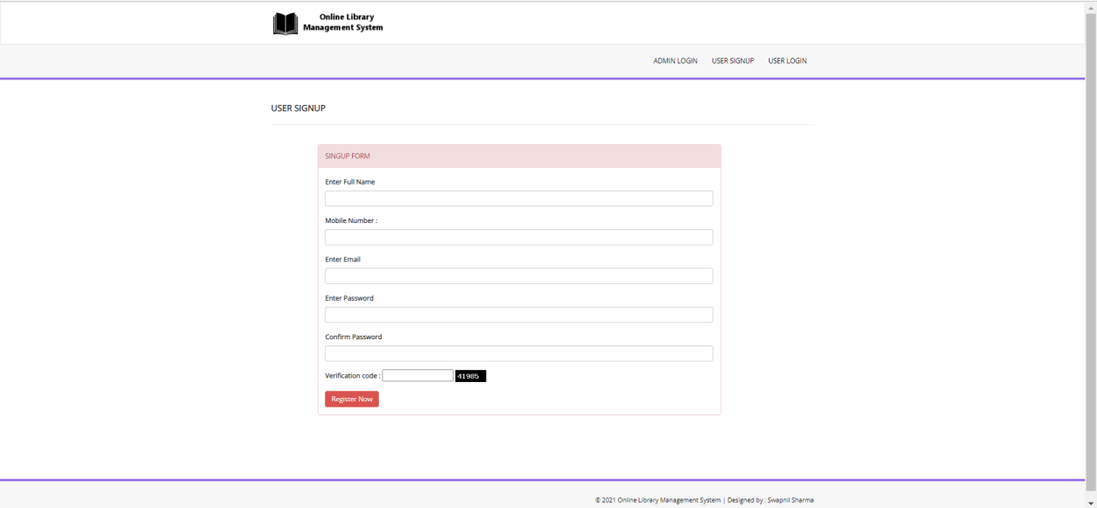
SignUp Page For New Student

Slide 5
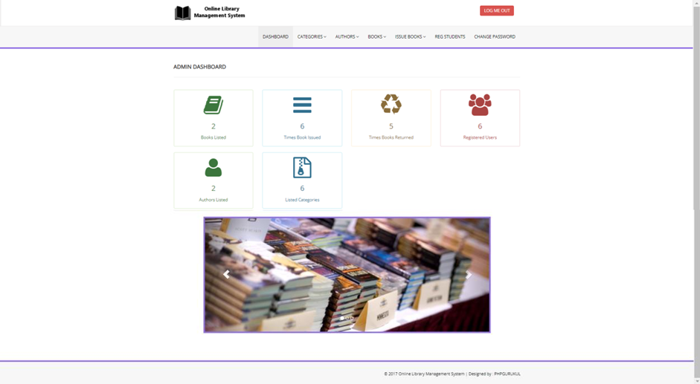
Admin Dashboard

Slide 6
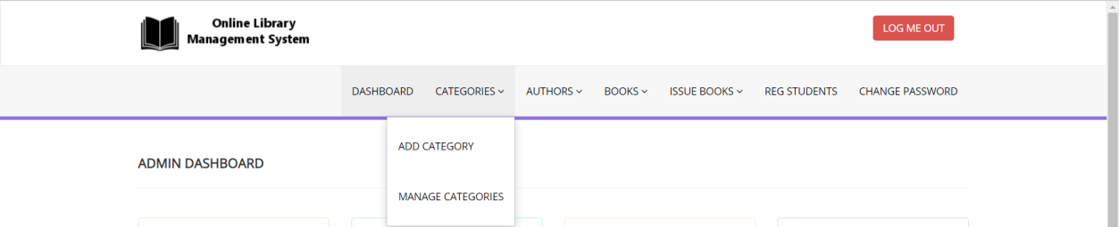
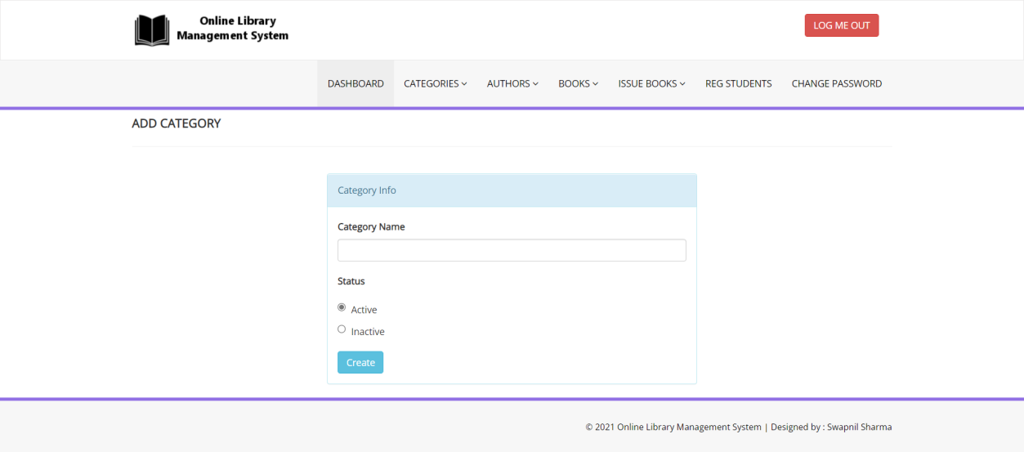
Categories
Add Categories

Slide 7
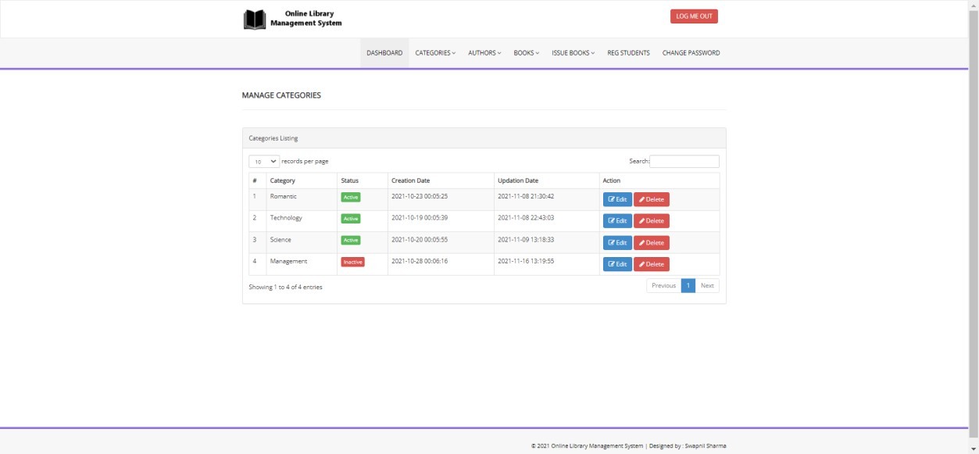
Manage Categories

Slide 8
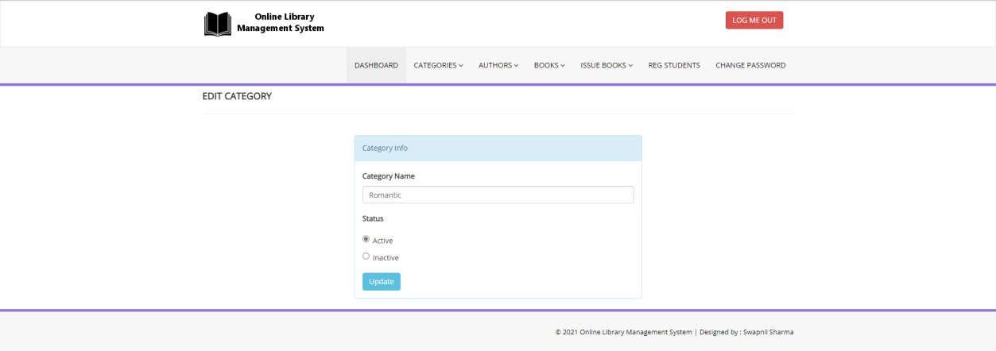
Update Category

Slide 9
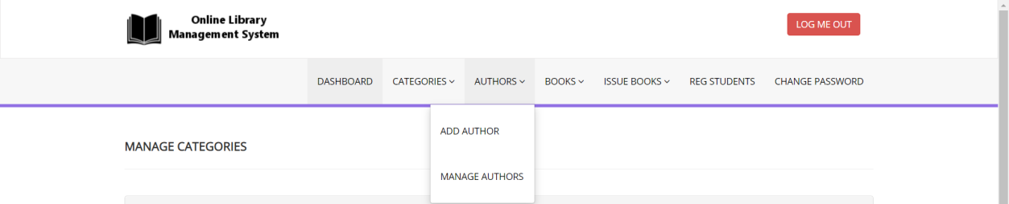
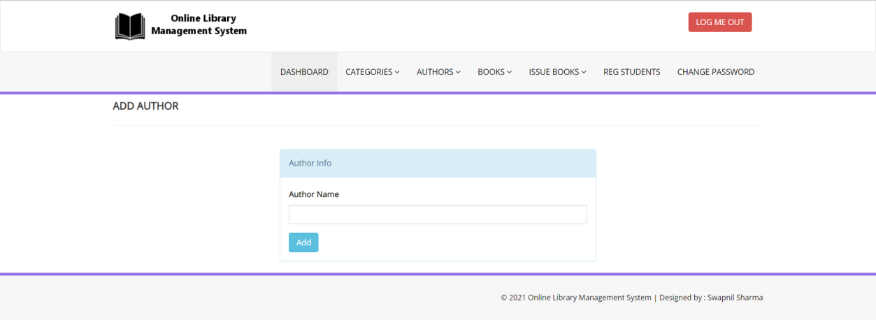
Authors
Add Authors

Slide 10
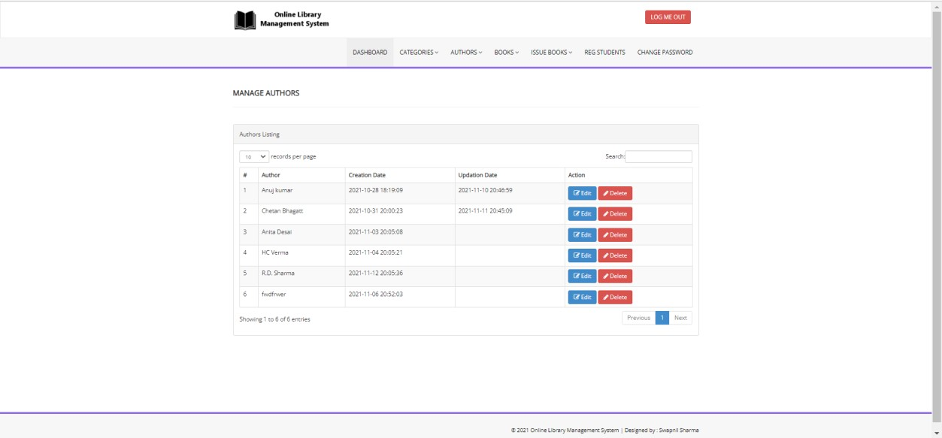
Manage Author

Slide 11
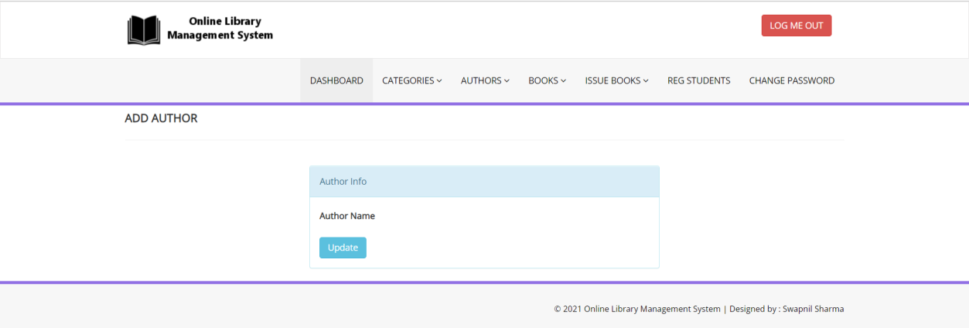
Update Author

Slide 12
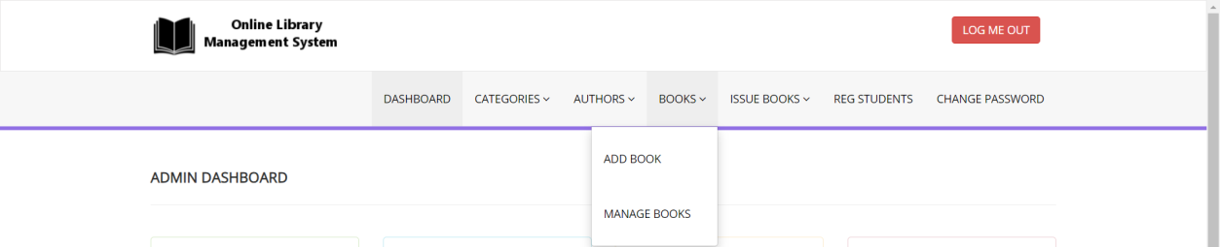
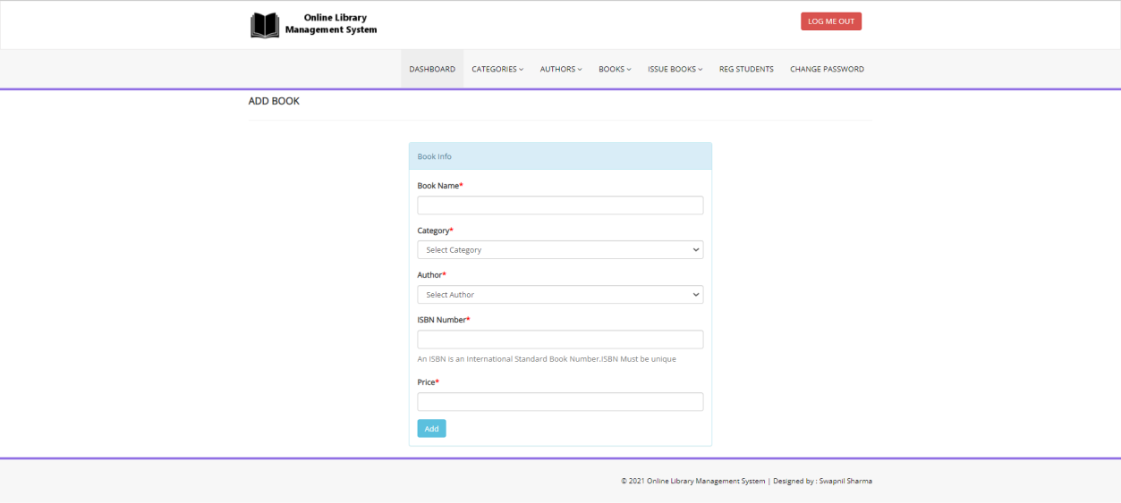
Books
Add Books

Slide 13
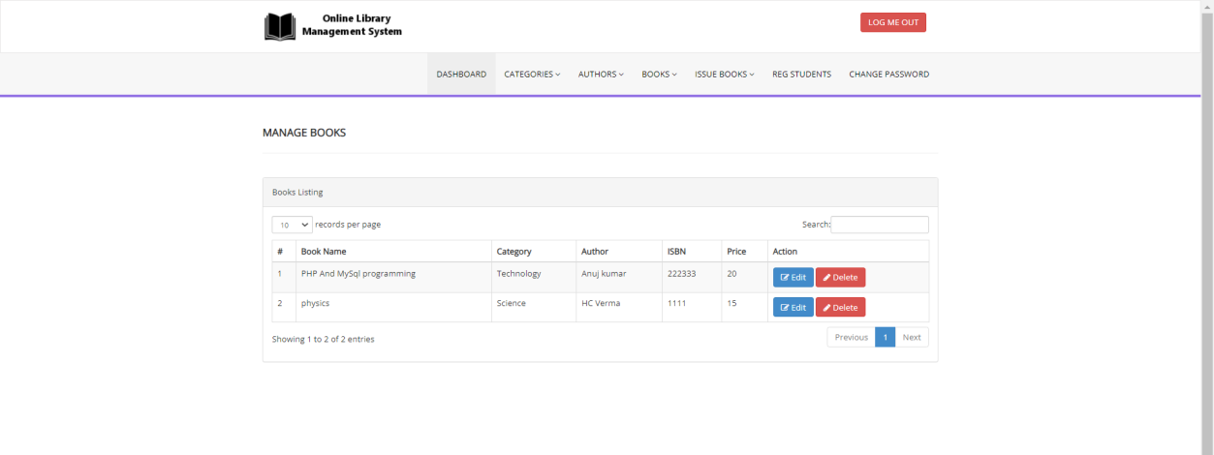
Manage Books

Slide 14
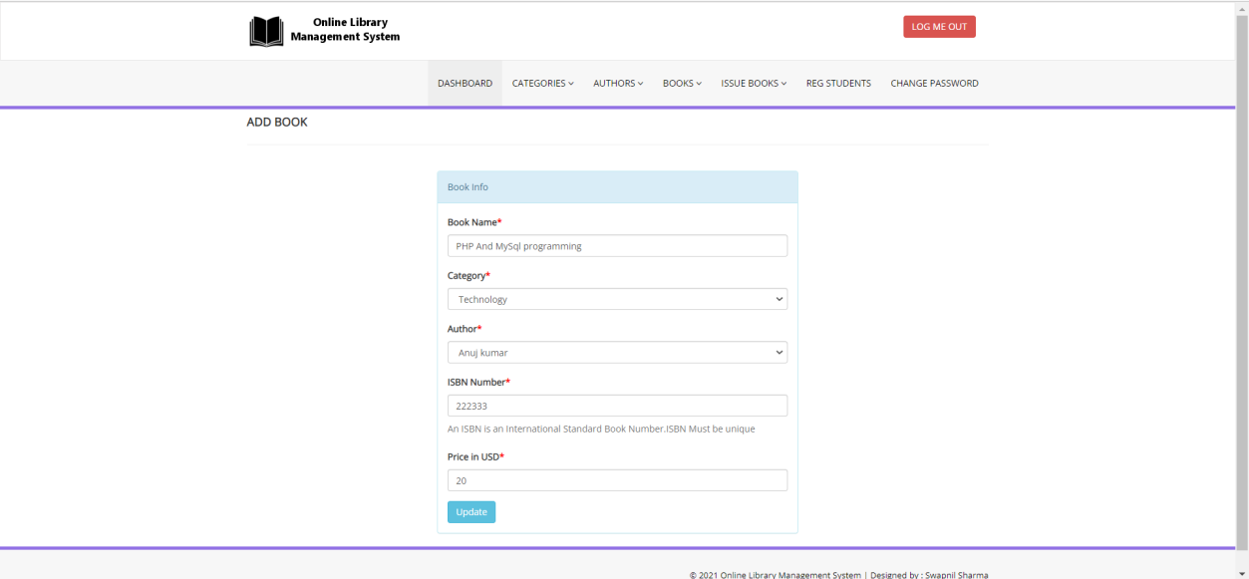
Update Books

Slide 15
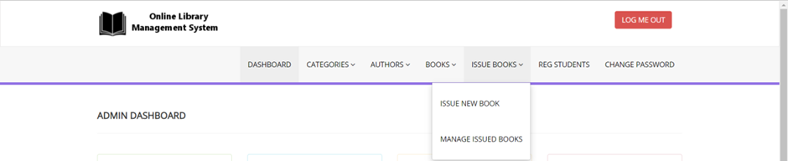
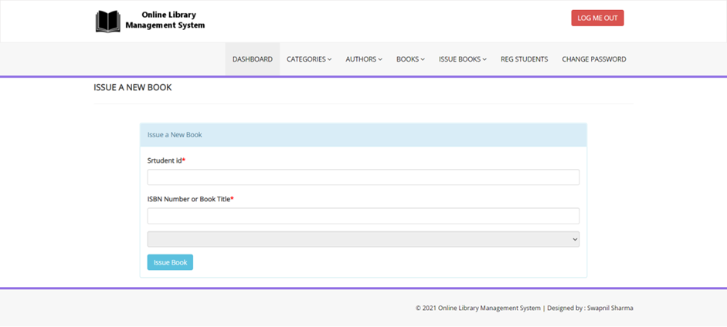
Issue Book
Issue New Book

Slide 16
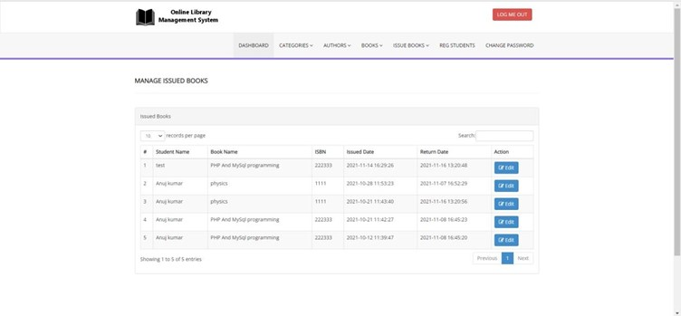
Manage Issued Books

Slide 17
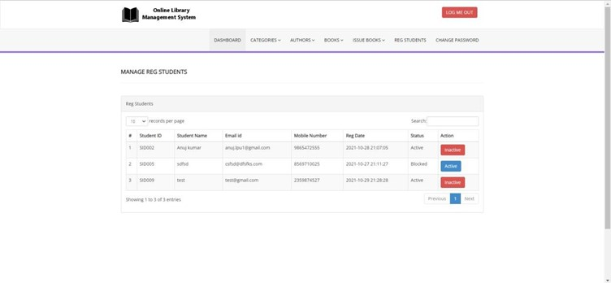
Register Student (User)

Slide 18
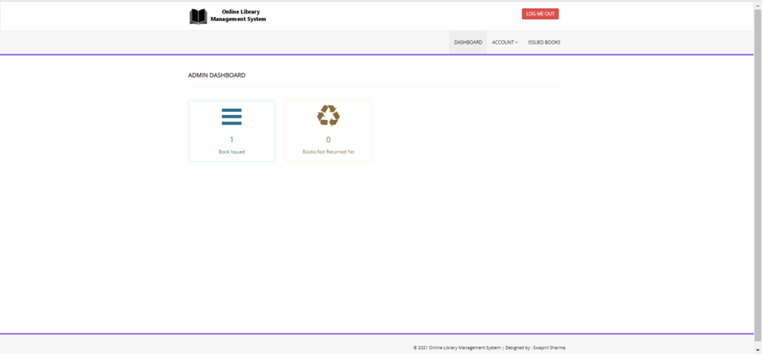
User Dashboard

Slide 19
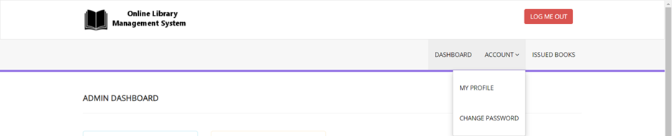
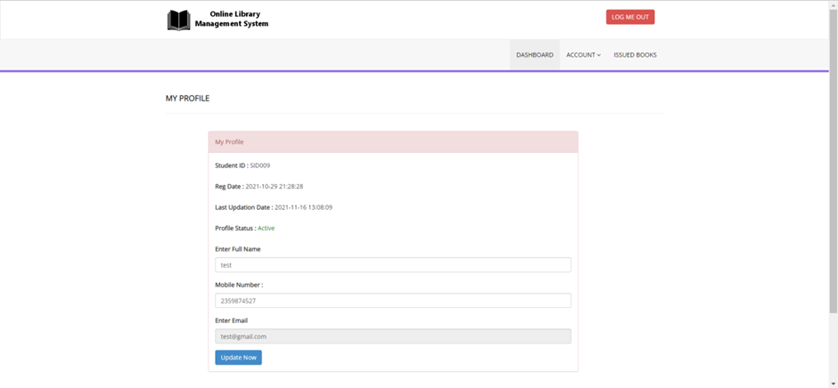
Account
User Profile

Slide 20
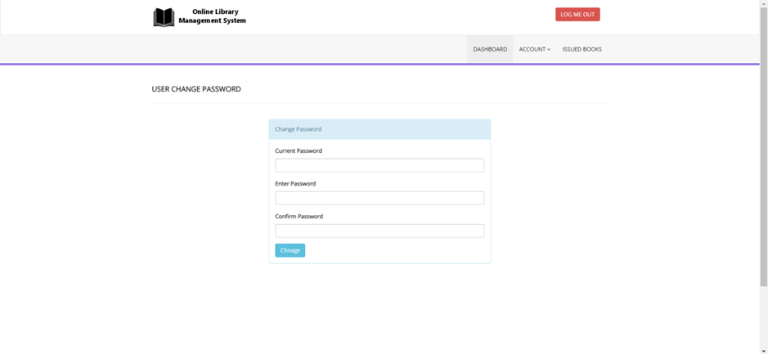
Change Password (User)

Slide 21
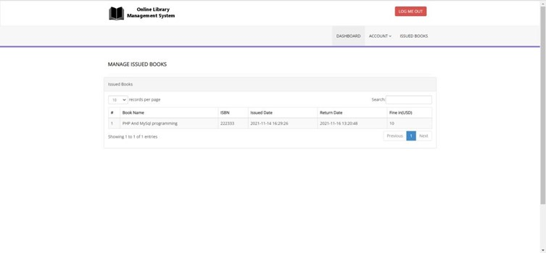
Issued Books

Slide 22


